Slide 1


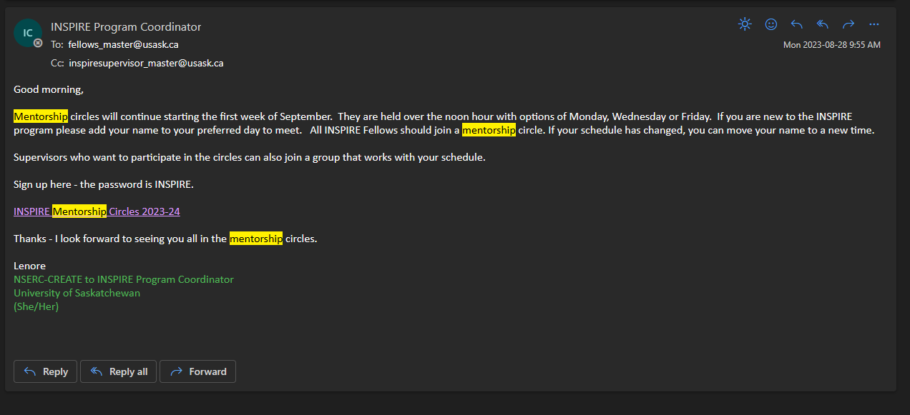
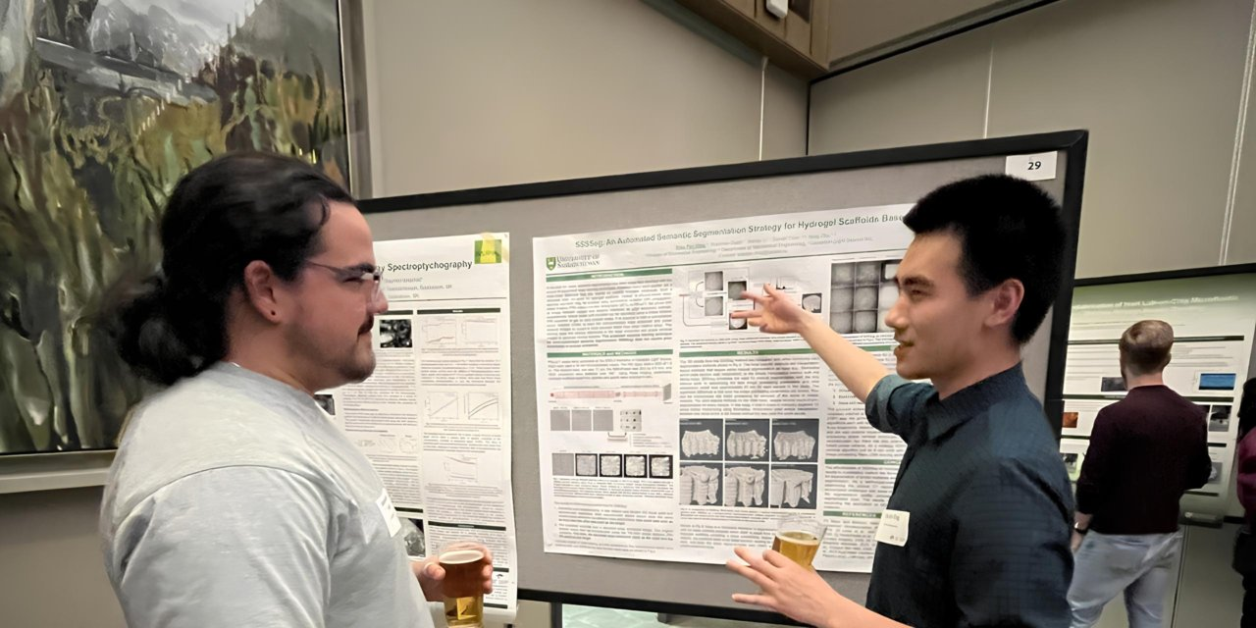
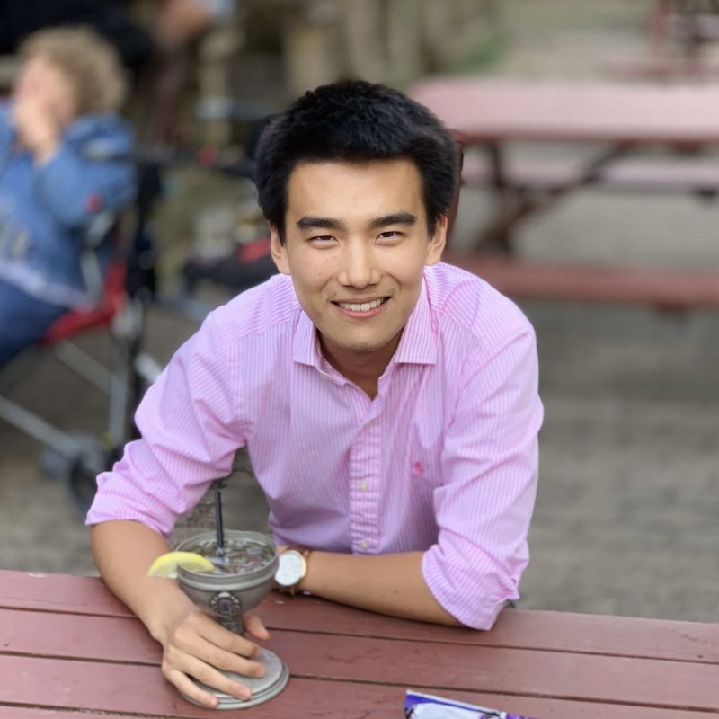
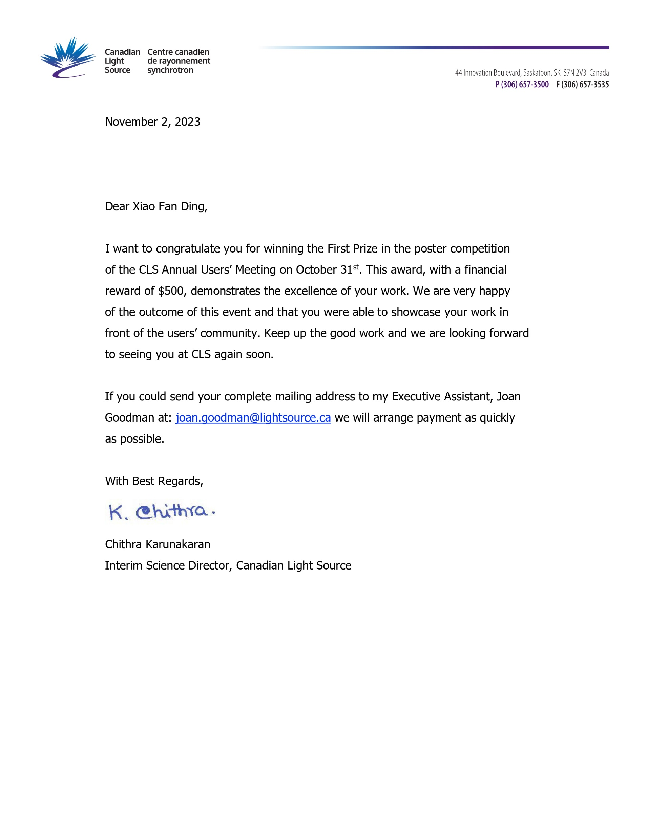
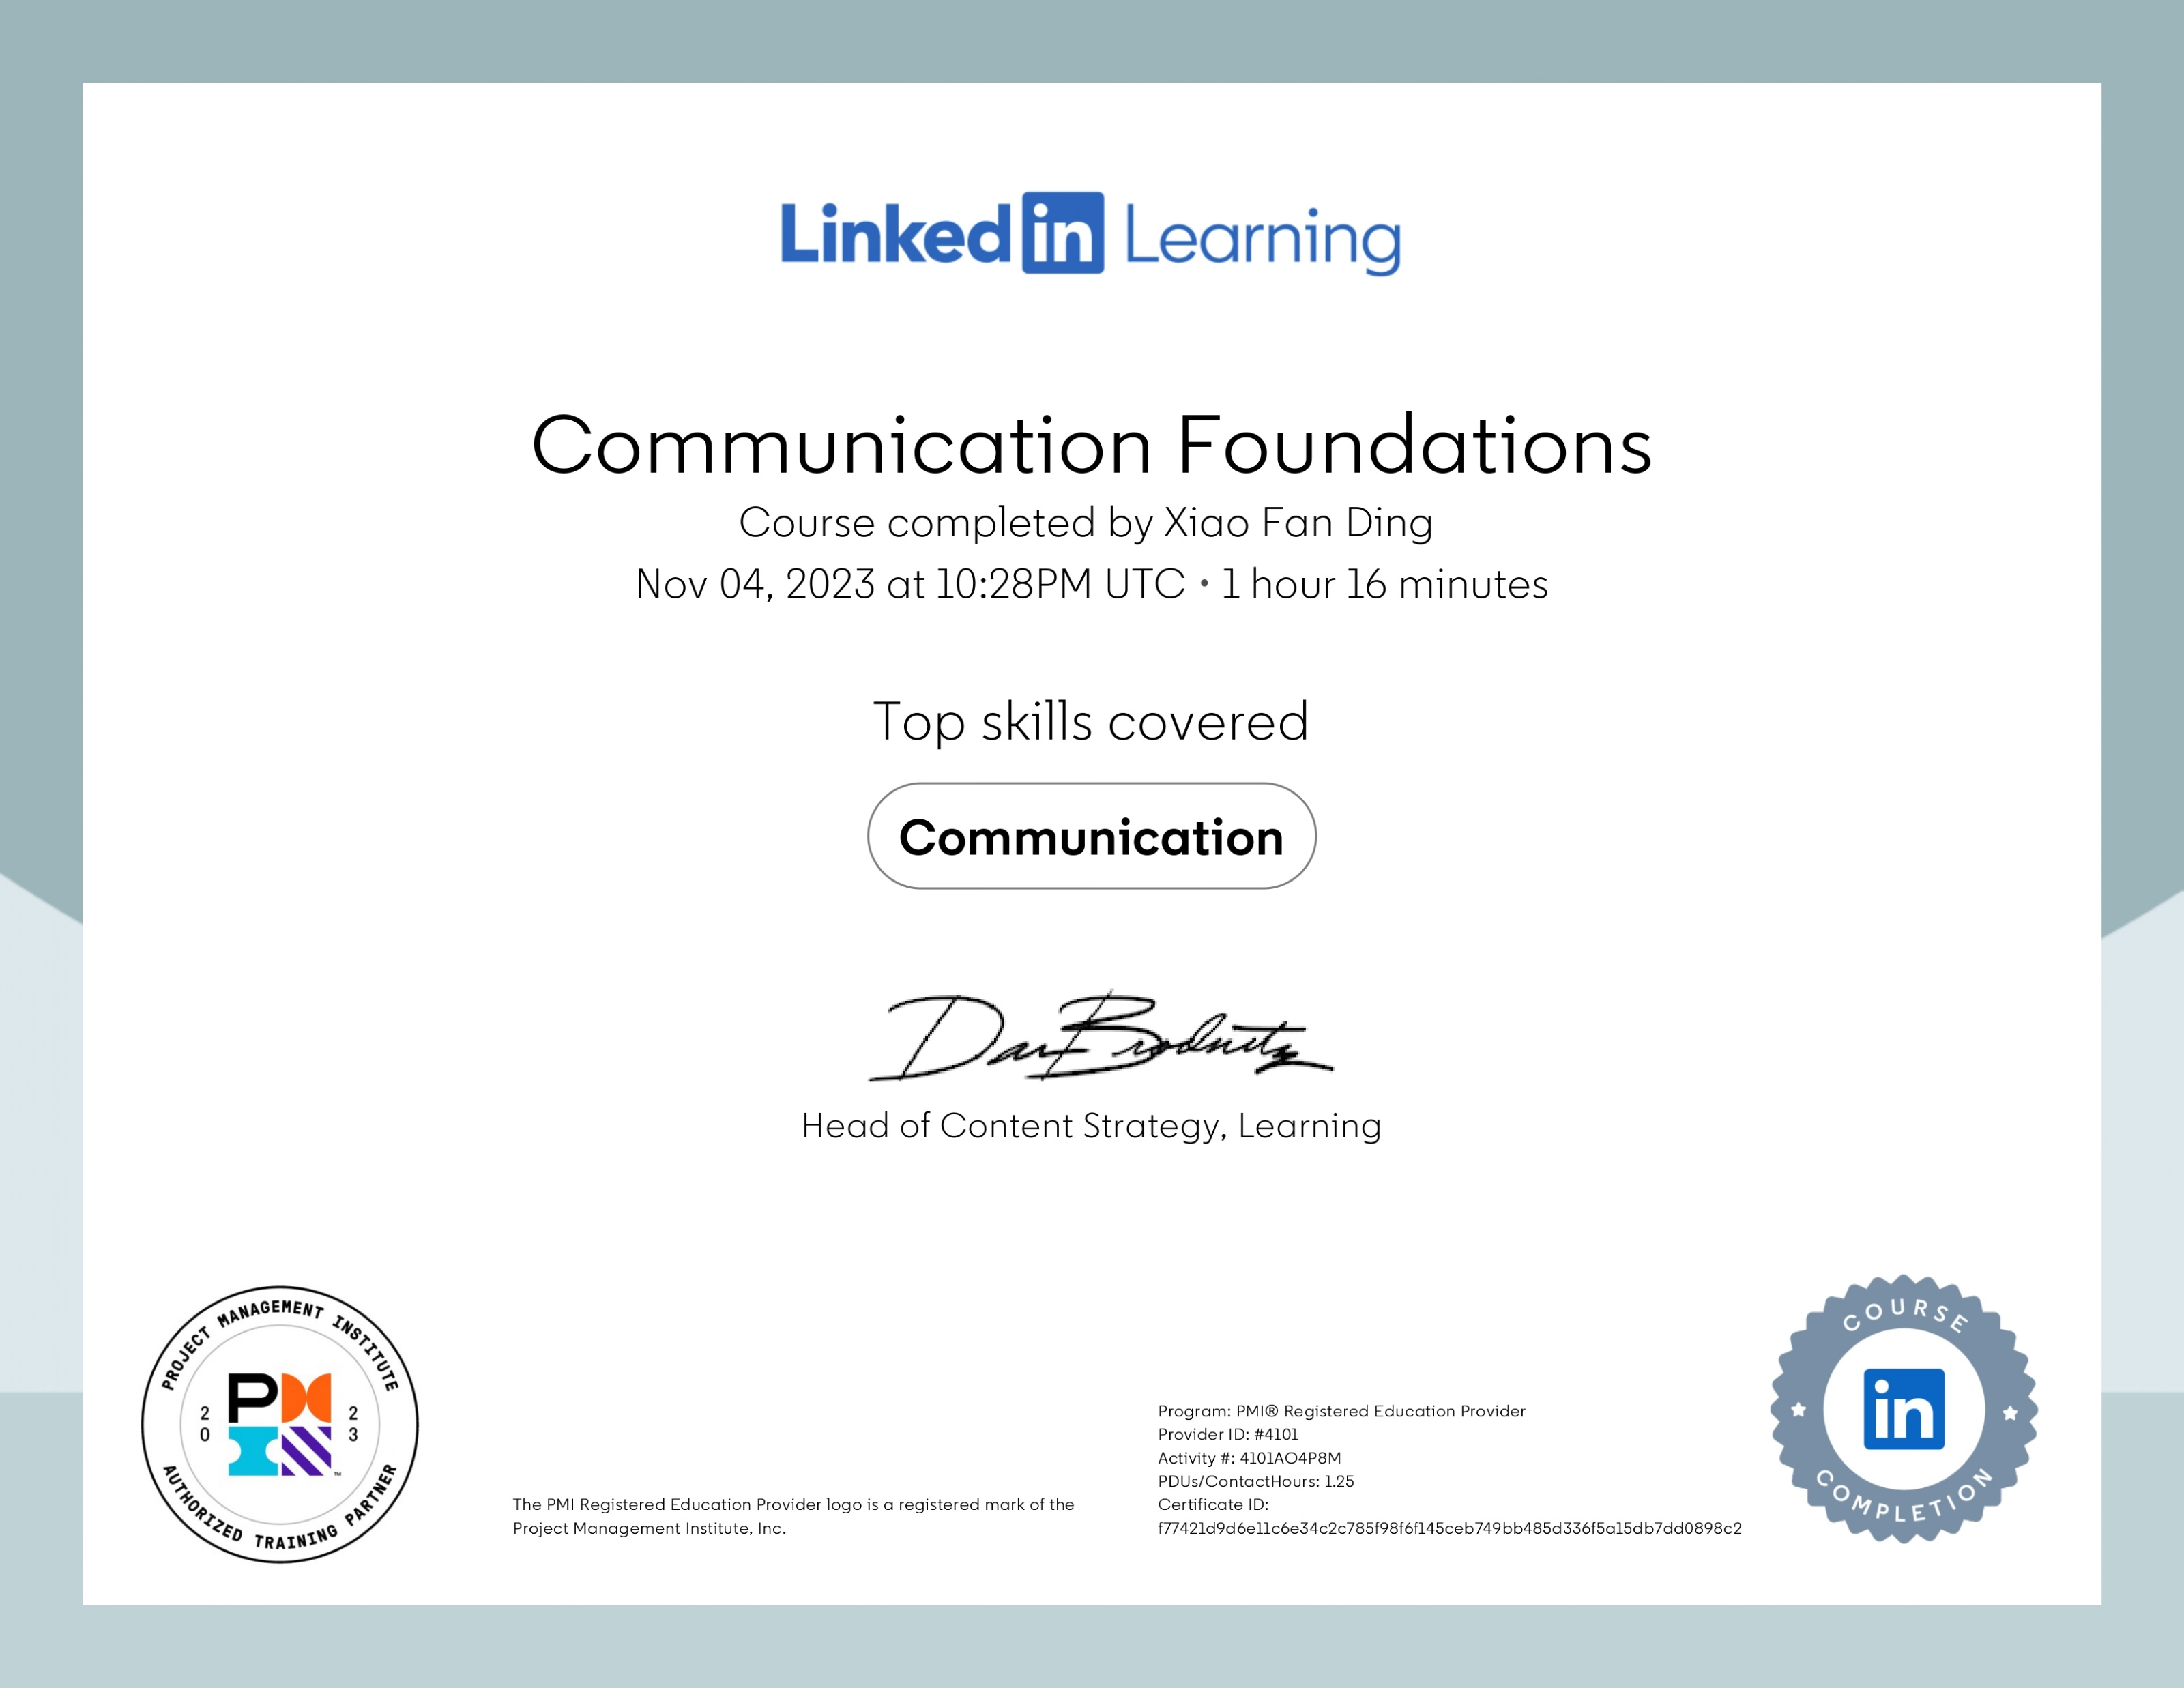


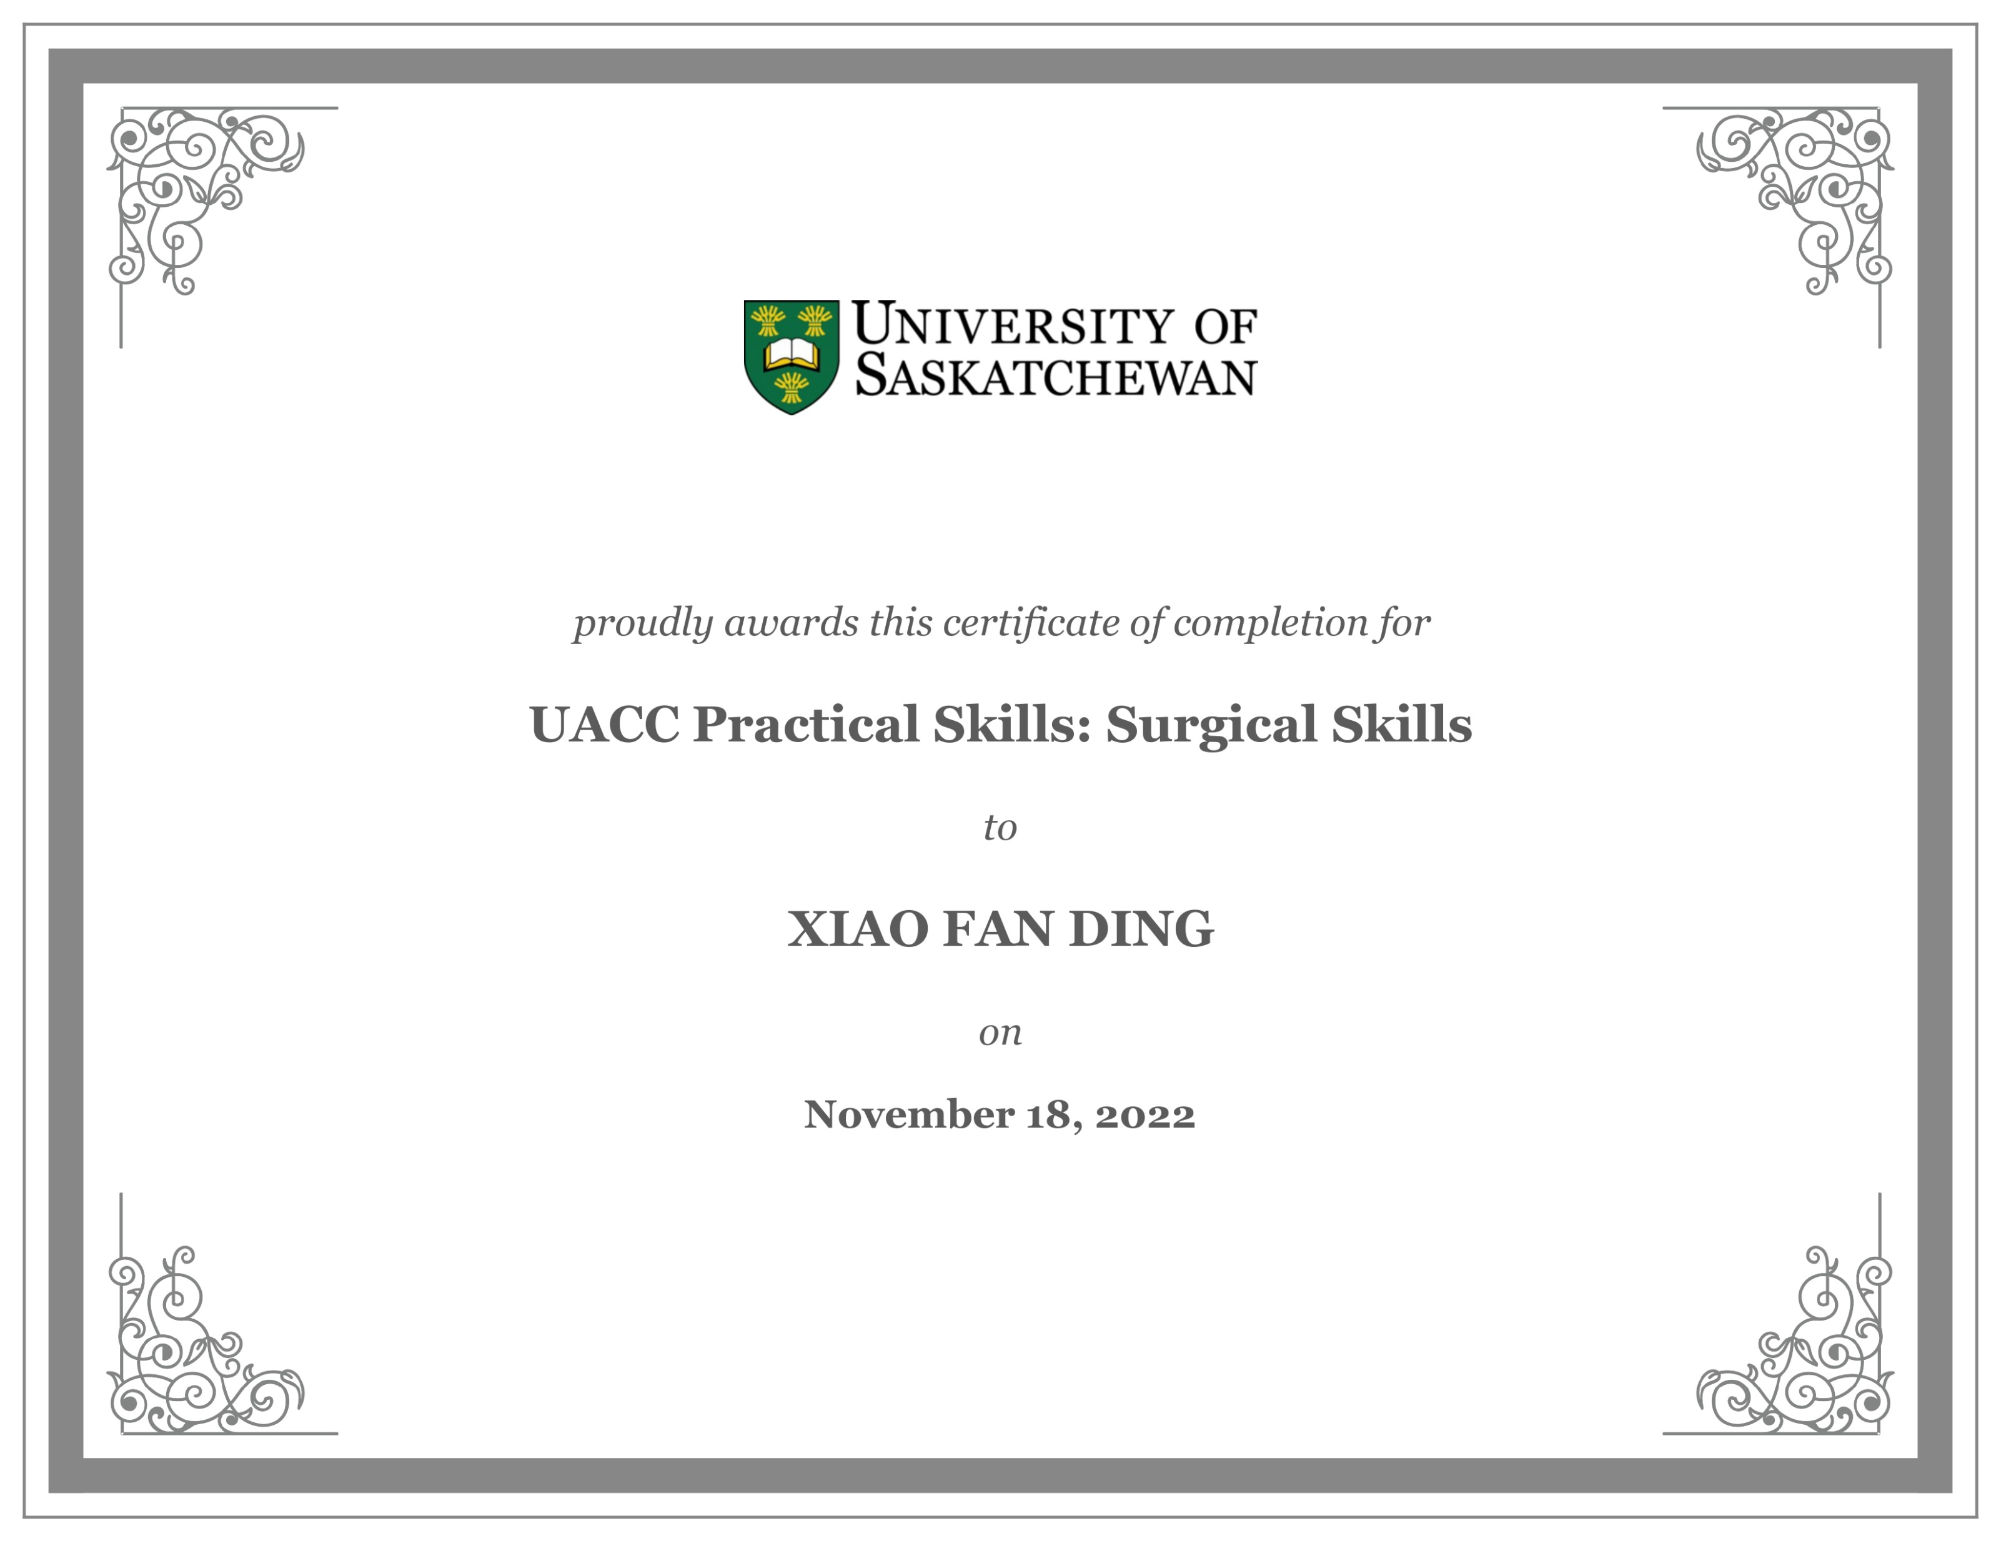

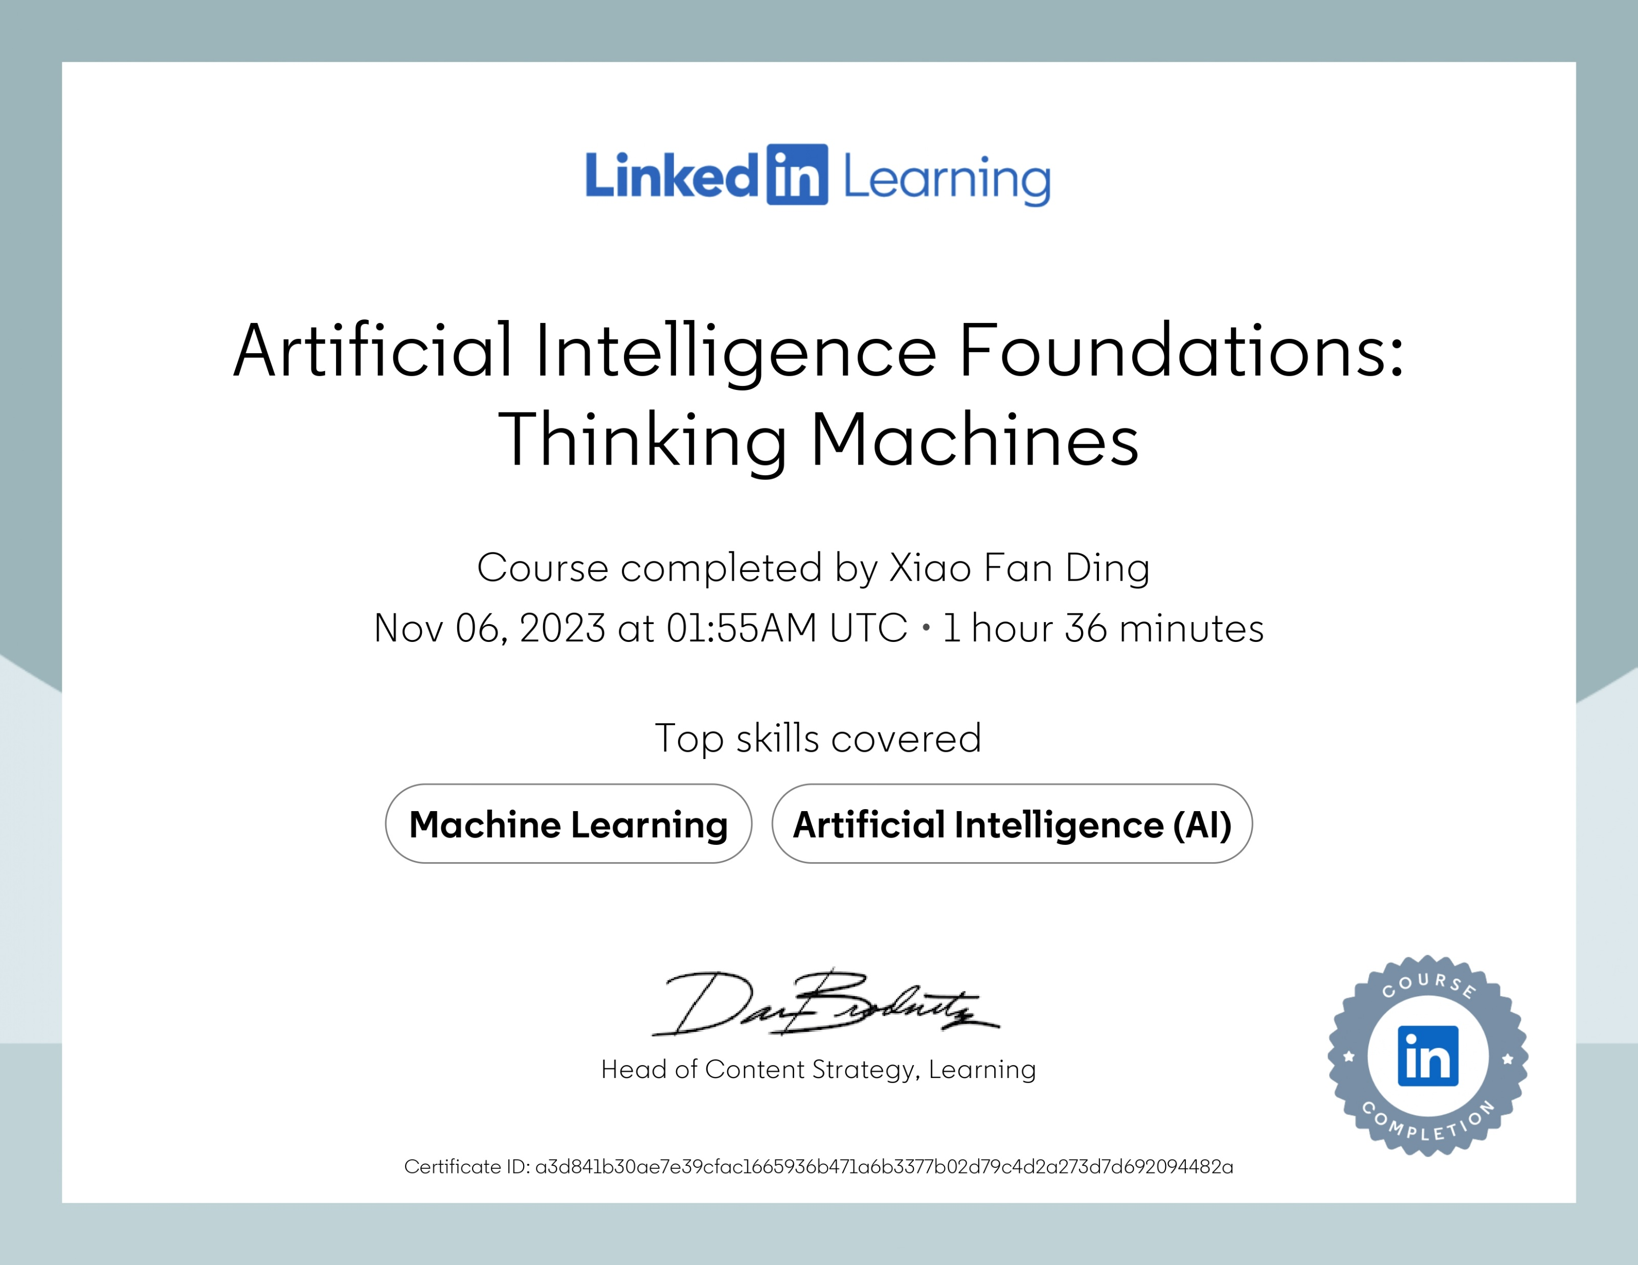

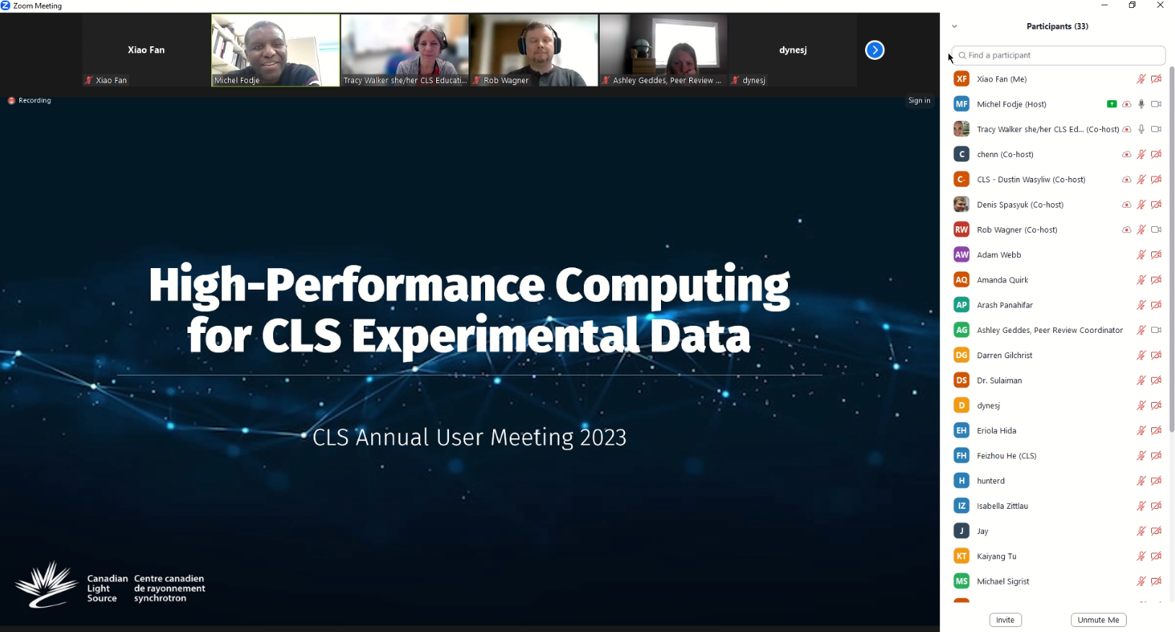

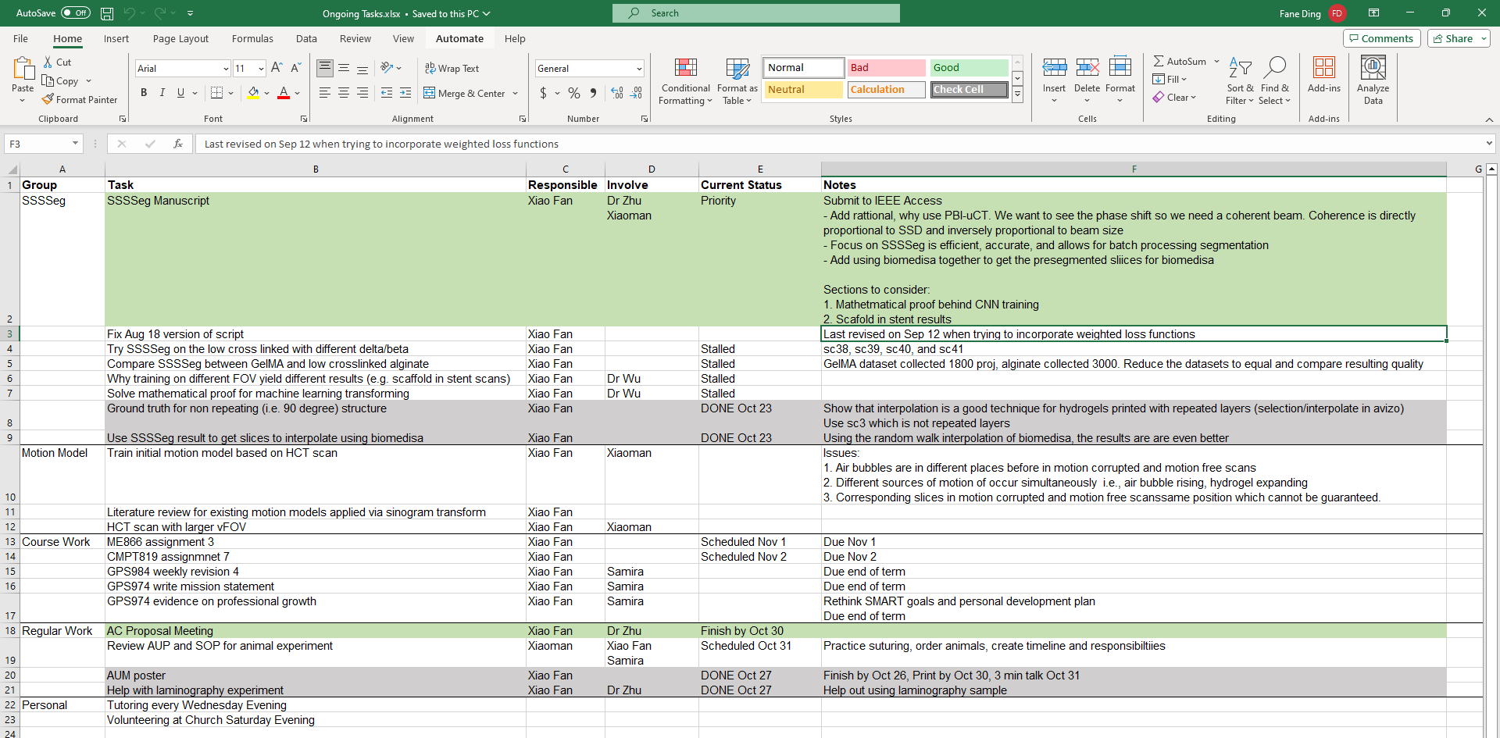
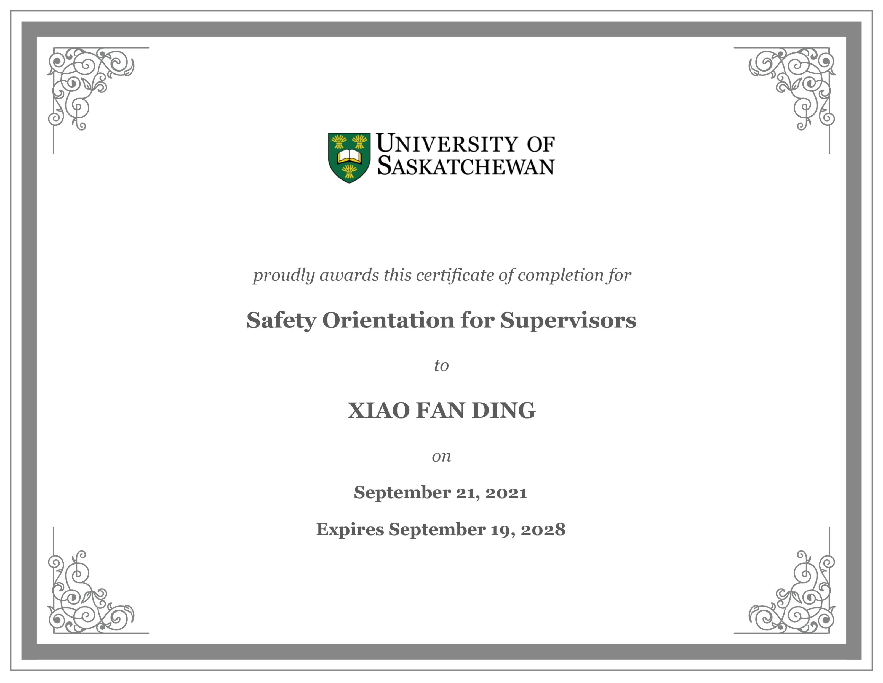
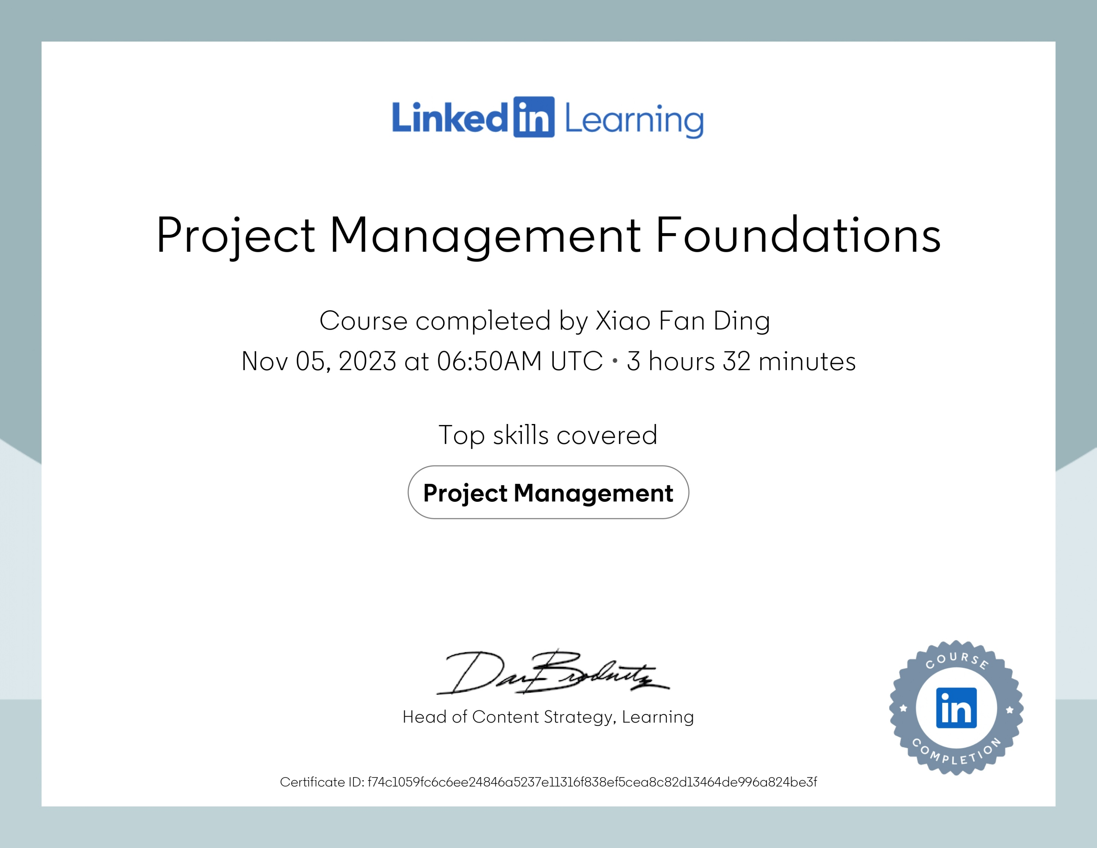
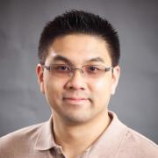
Xiao Fan Ding
PhD Student in Biomedical Engineering
Goal 1: Communication
Mission Statement:
Uphold the values of honesty, accountability, community, support, and growth. Bridging the gaps across disciplines. Contribute meaningfully to the scientific community and continue as a lifelong learner.
Goal 2: Domain Knowledge
Goal 3: Time/Project Management
Top Strengths: 1. Honesty
2. Fairness
3. Forgiveness
4. Curiosity
5. Love of Learning
Personality:
72% Introverted
52% Intuitive
52% Feeling
57% Prospecting
58% Turbulent
Type: Mediator (INFP-T)
Role: Diplomat
Strategy: Constant
Improvement

